Slide 1
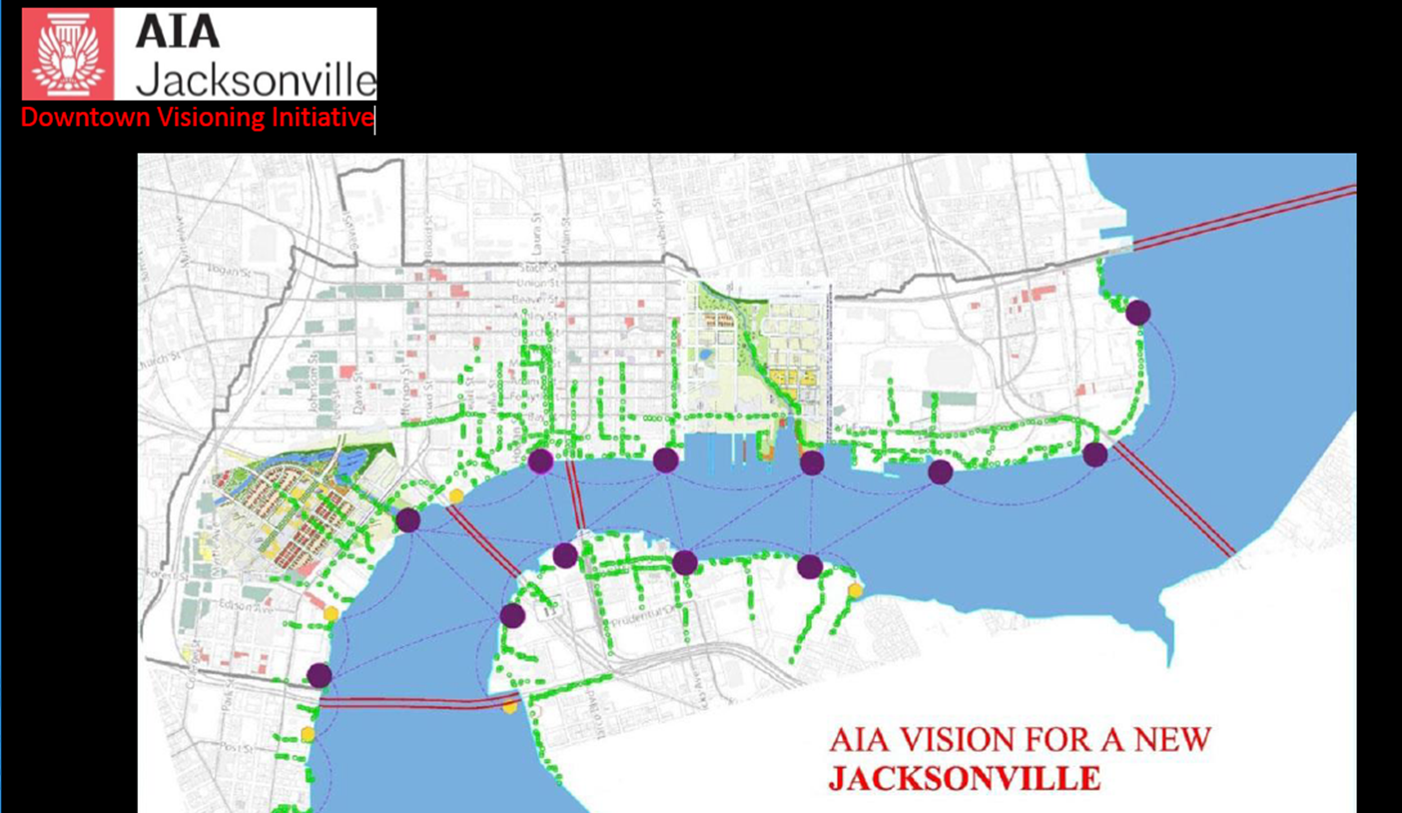
The Downtown Experience-Landscaped Riverwalks and Nodes
Immerse yourself in beauty, inspiration, music, food and history along a vibrant Downtown waterfront

Slide 2
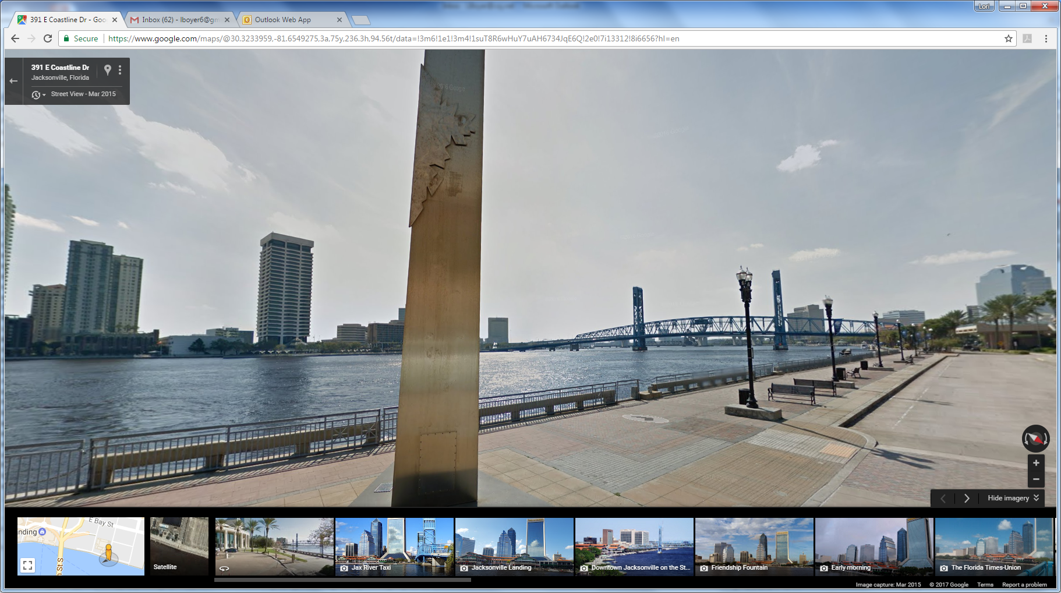
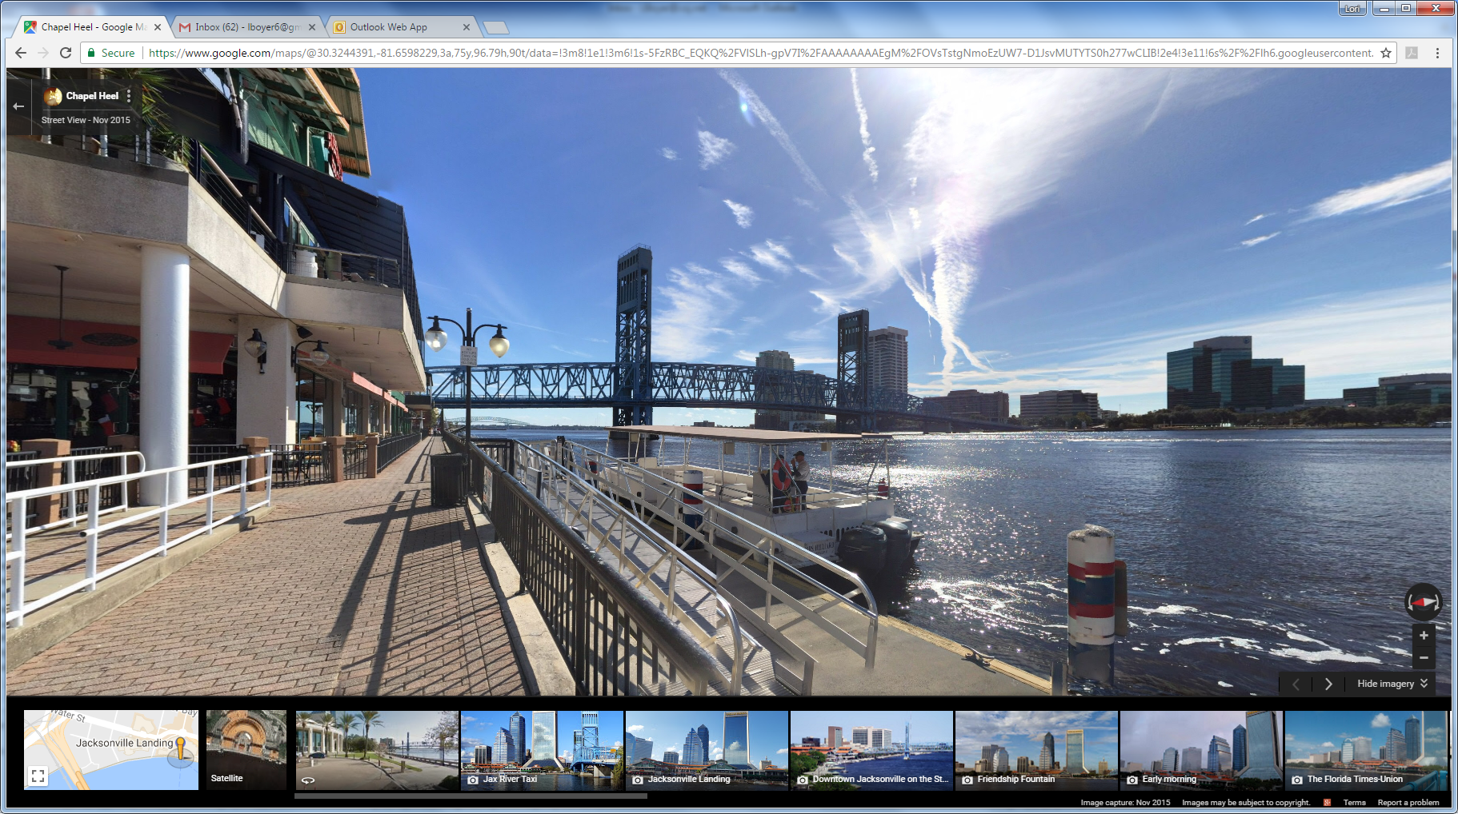
Today our Riverwalk is functional but cold and sterile

Slide 3
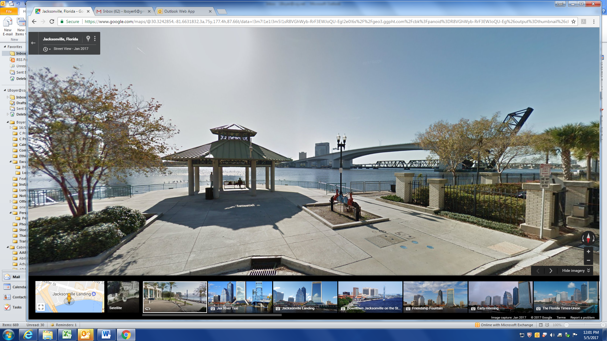
How do we transform this into an engaging, inspiring, experience that becomes a must see for Jacksonville?

Slide 4
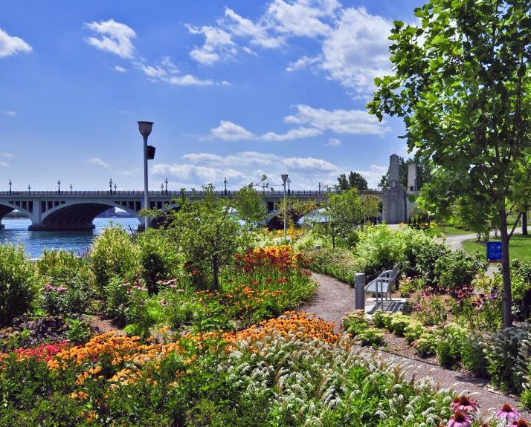
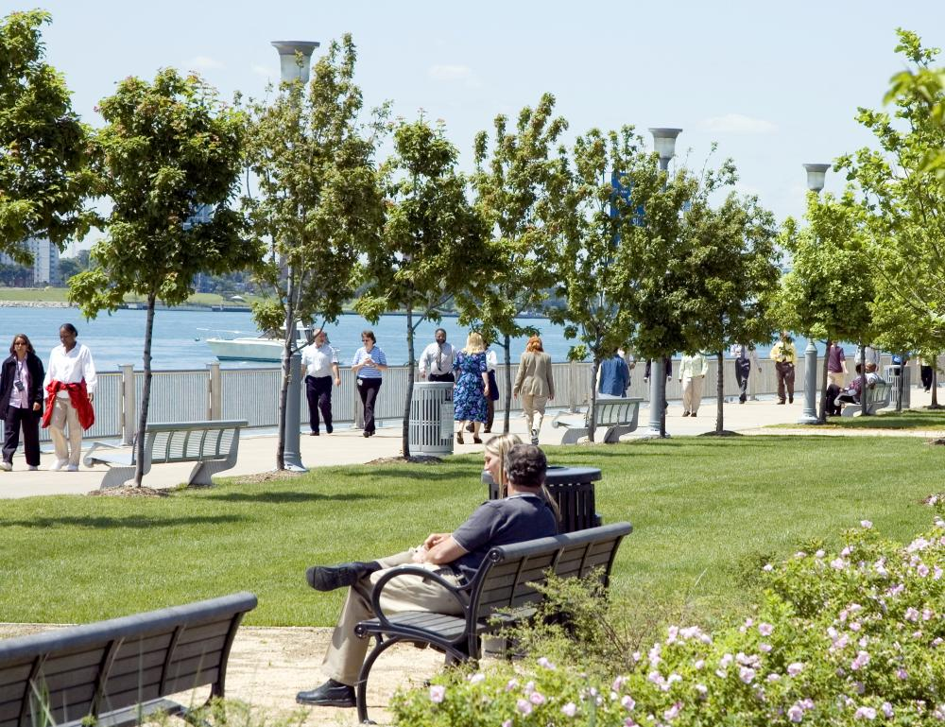
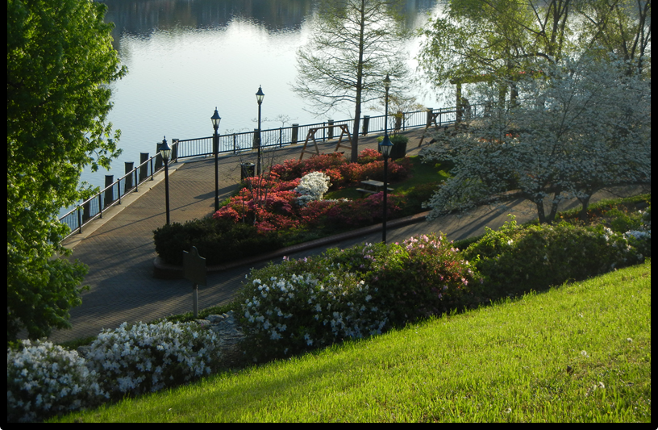
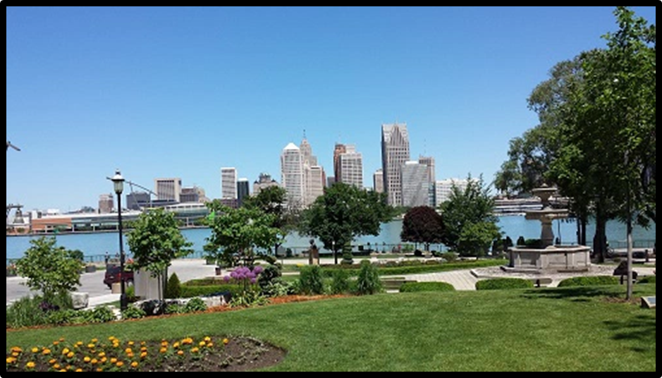
Landscape is one element
Themed Pocket Gardens will create distinctive and beautiful places

Slide 5
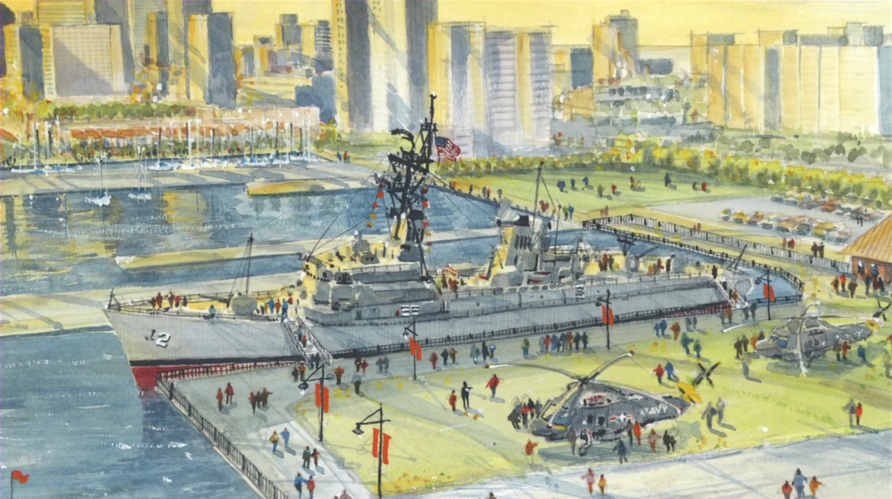
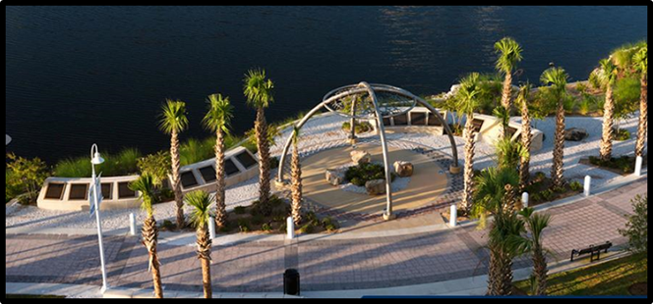
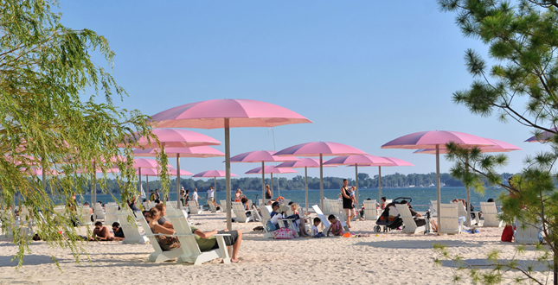
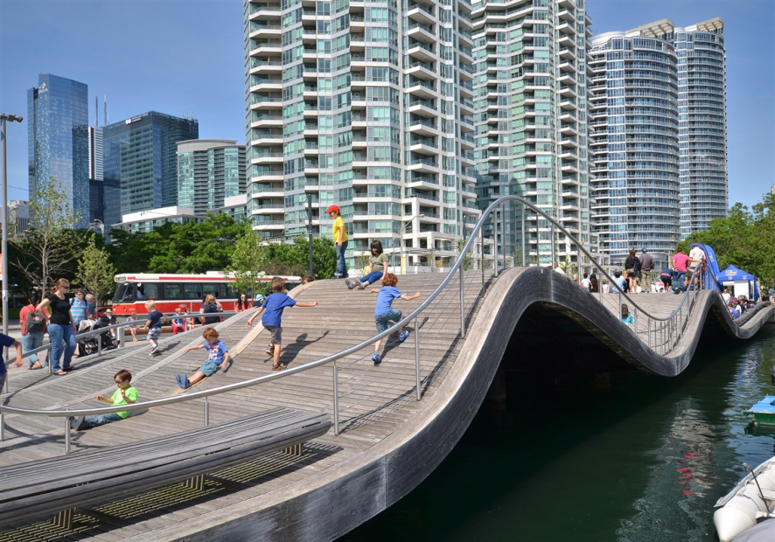
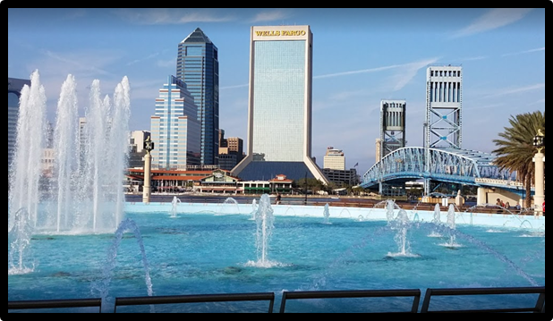
Iconic features

Slide 6
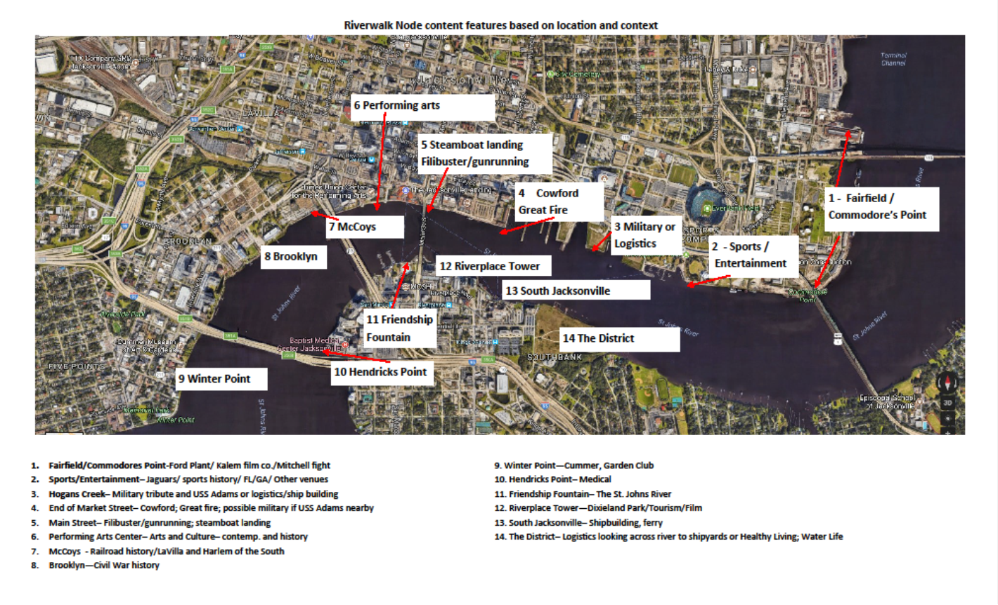
Jacksonville stories brought to life

Slide 7
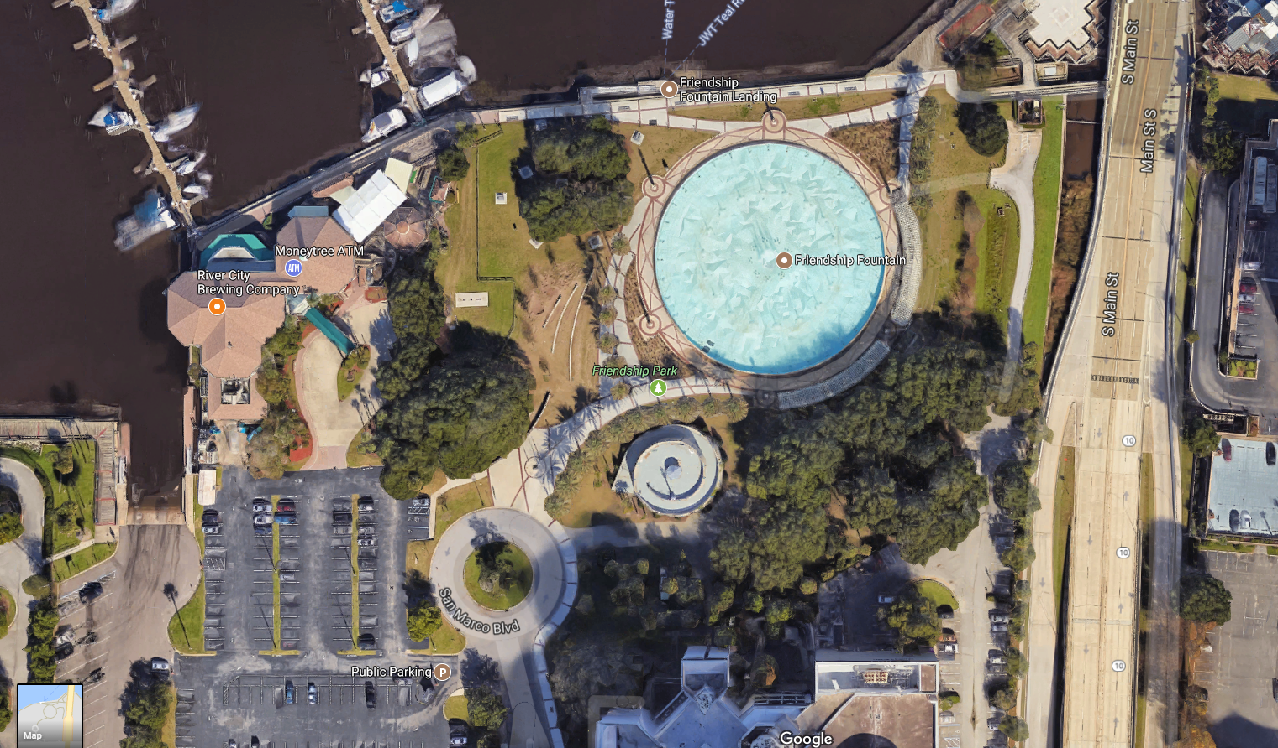
Friendship Fountain and its relationship with MOSH-
Incorporating and interpreting the stories of the St. Johns River
The Fountain is the iconic feature
Surround with garden space/hardscape that interprets the river, provides viewing space, engages visitors to park
Food and play options

Slide 8
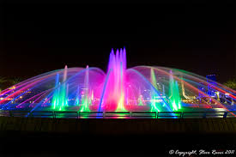
Create a wow factor: Focus on a multimedia light/water/sound production using the fountain as the starting point

Slide 9
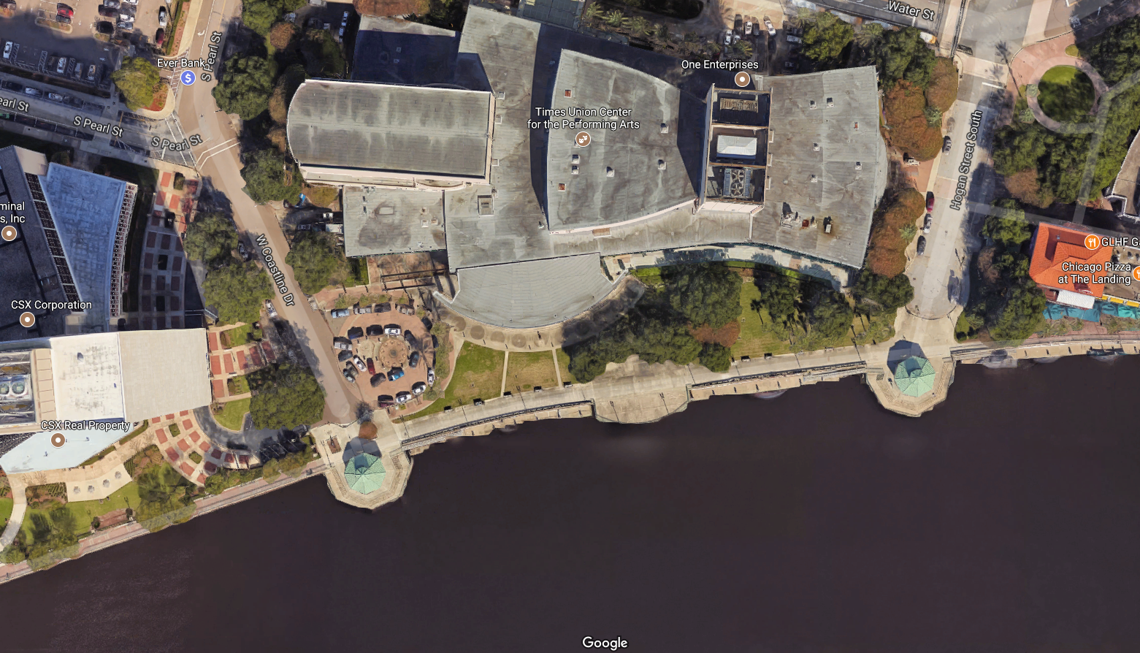
Times Union Performing Arts Center
and space between Hogan and Pearl/Coastline
along the waterfront

Slide 10
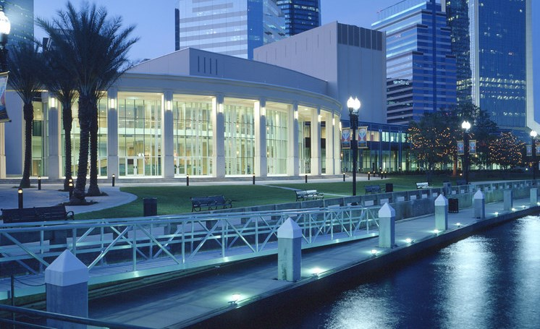
Focus on Performing Arts
Connect facility with outdoor space through dining, performances

Slide 11
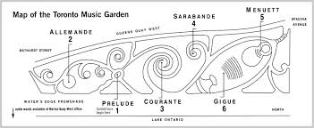
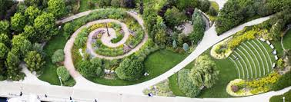
A garden space that interprets performing arts- think Toronto Music Garden
But includes interaction with the Center- dining, outdoor performance space,….
Includes an iconic feature
Incorporates light show element to interact with Fountain

Slide 12
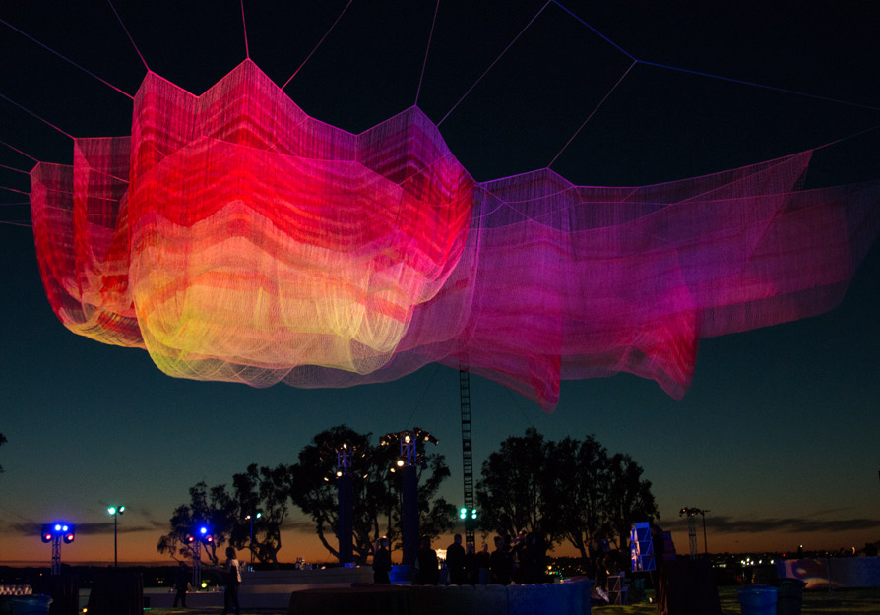
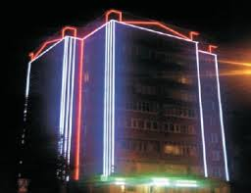
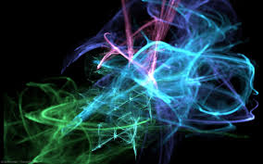
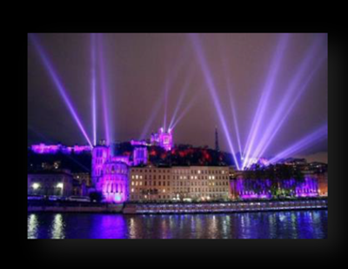
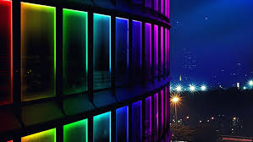
The Light feature at this node, that would interact with the fountain show could be an
Echelman net sculpture floating above the building
A laser beam aerial show from the roof
LED light show on the façade
Or possibly a Laser show projected on a mist or screen on the roof

Slide 13
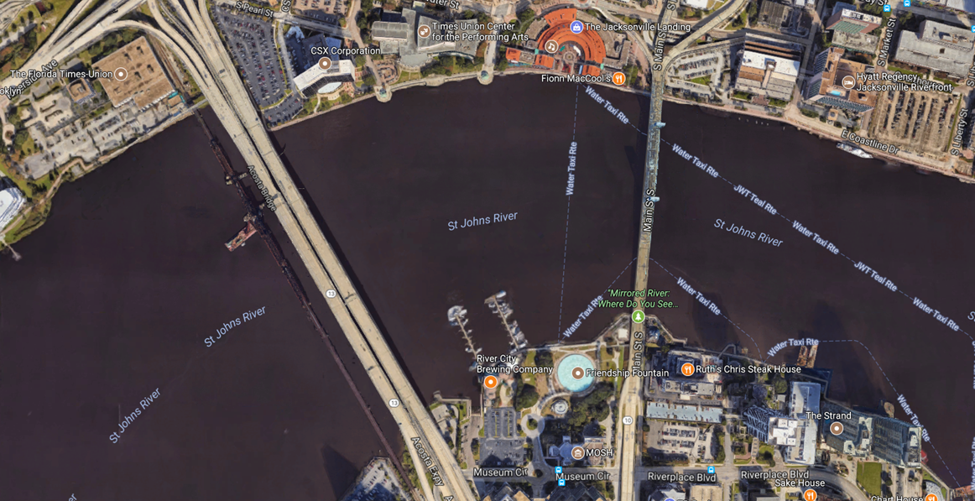

Slide 14
